Slide 1
Campus Exchange
A Second-hand Trading App
CS673 Software Engineering Iteration 2
Team2: Scrumble Bug
Date: Nov 7 2024

Slide 2
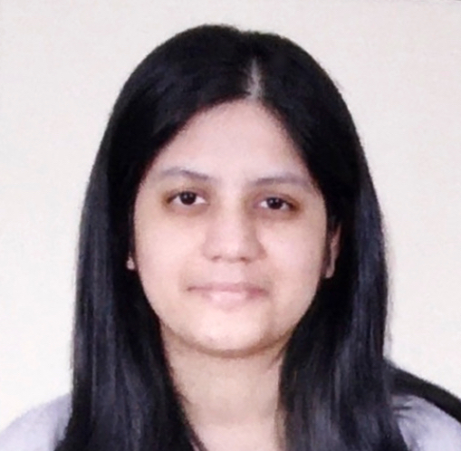


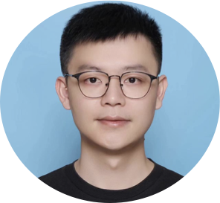

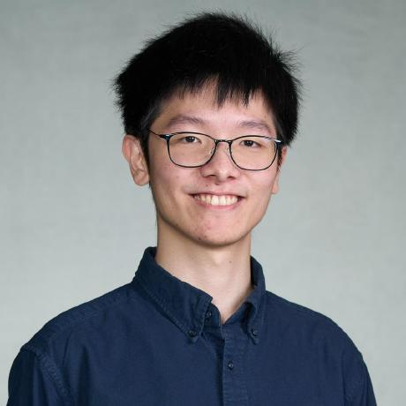
Team Building
Srujana N
QA Leader
Yueyihan Qi
Security Leader
Yingtong Zhou
Team Leader
Yuanbin Man
Requirement Leader
Ang Li
Design and Implementation Leader
HungHsu Chen
Configuration Leader
Notes:
QA Leader
Help choose or create quality metrics, review process, testing plan, reporting methods, and monitor mechanisms.
Security Leader
Identify risks among the project and come up with solutions to prevent the risks
Design Leader
Planning workload

Slide 3


Project Vision (Recap)
Goal
Create a peer-to-peer platform for BU students to buy and sell used items within their campus.
Target Audience
Boston University students, including both buyers and sellers.
Problem Statement
Students have used items they no longer need, but current marketplace apps are either too broad or unsafe for campus use.

Slide 4
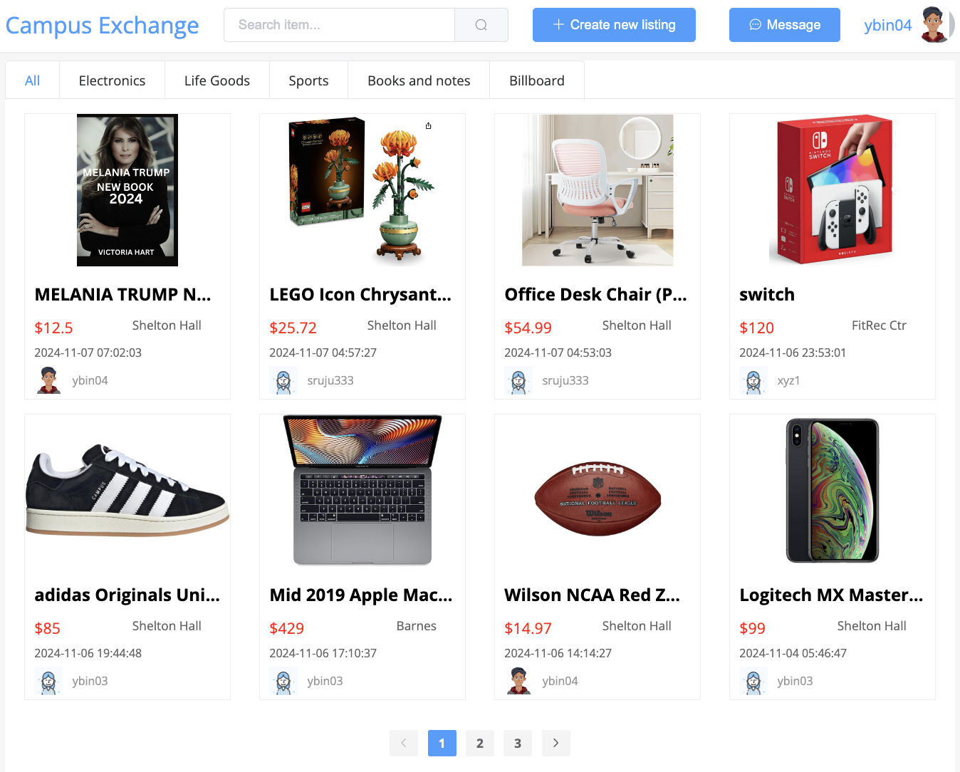
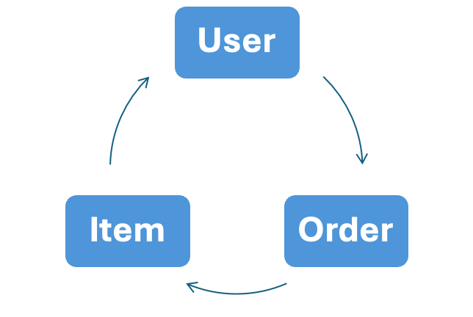
New Updates (Iter.2)
New
User
Set up with Email (Activation Code).
My profile (passwd, location, phone .etc)
Management (items, favorites, cart, orders .etc)
Admin Panel (items, users, orders .etc)
Item
Pagination Search (order).
Chat or Message.
Favorites.
Shopping Cart.
Order
Buy: Purchase Item (Face2Face [offline])
Sold: Cancel order;
Meeting location.
Offline Item after deal.
http://47.253.44.235:8080/
Notes:
specific textbook
narrow the listing – more related to BU students
include comments – no repeated questions for sellers – better user experience

Slide 5
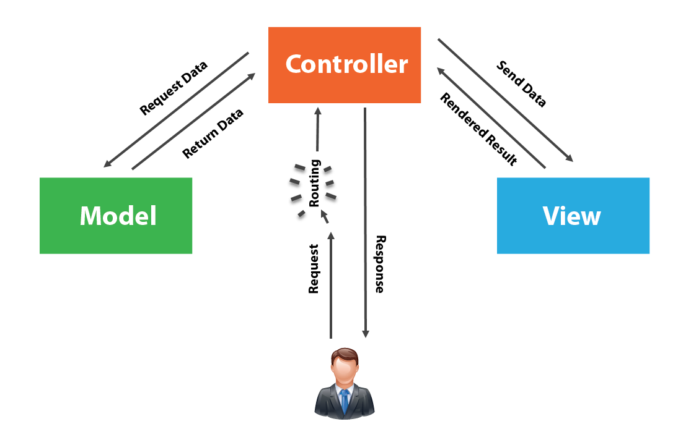






Software Design
Frontend
Vue.js
Backend
Spring Boot MyBatis
DevOps/CI/CD
Docker
Kubernetes
Database
MySQL
Notes:
specific textbook
narrow the listing – more related to BU students
include comments – no repeated questions for sellers – better user experience

Slide 6
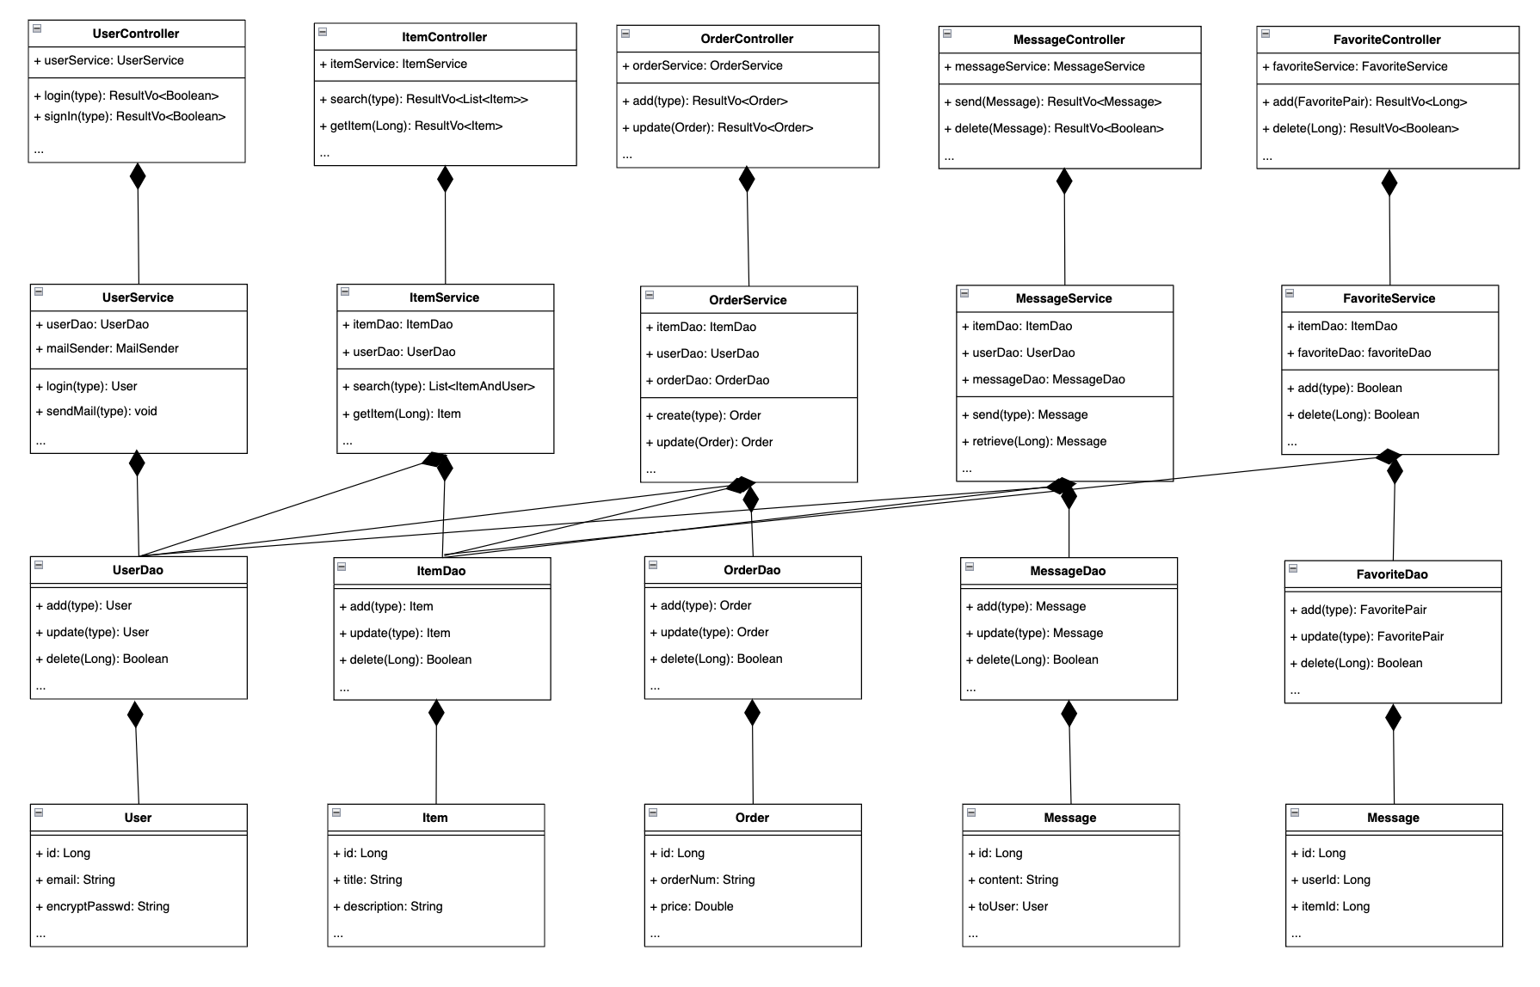
Class Diagram
Controller:
Service:
Dao:
Entity:
Notes:
specific textbook
narrow the listing – more related to BU students
include comments – no repeated questions for sellers – better user experience

Slide 7
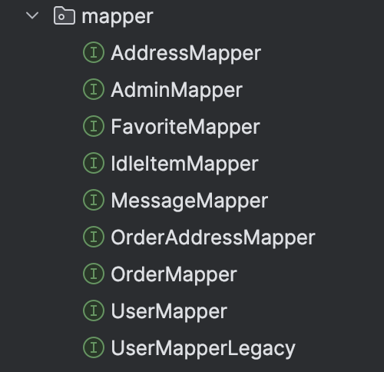
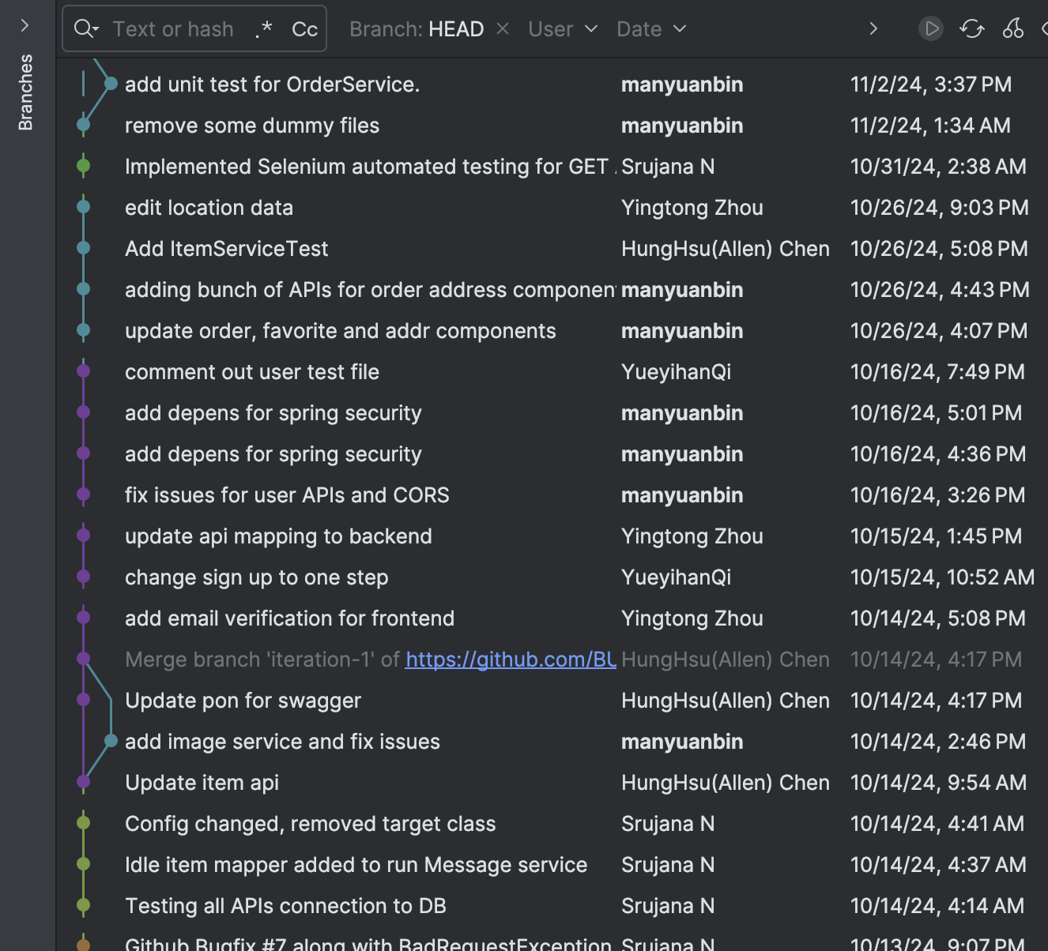
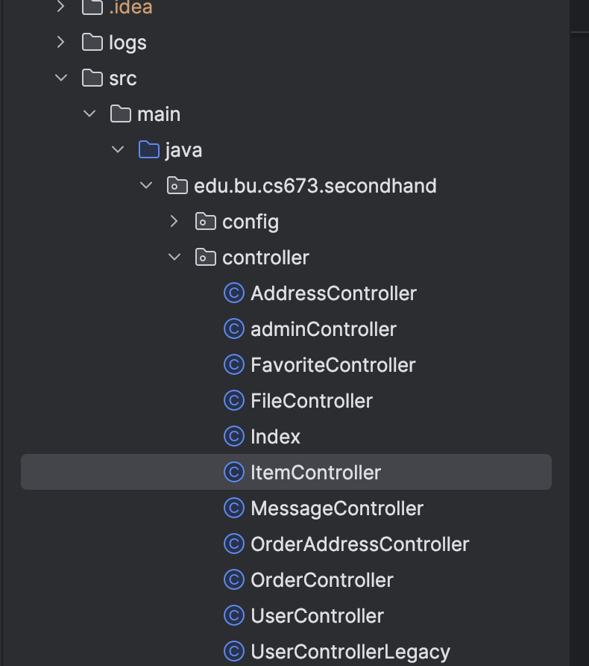
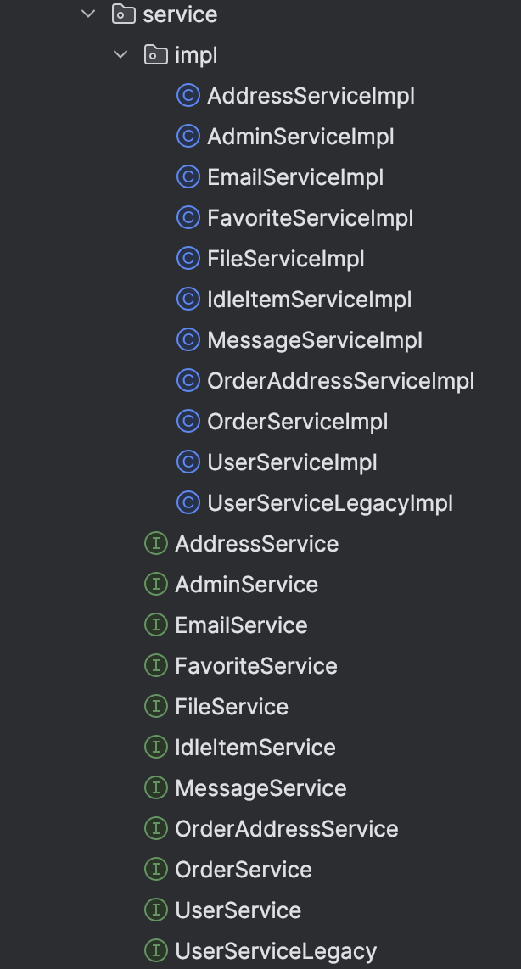
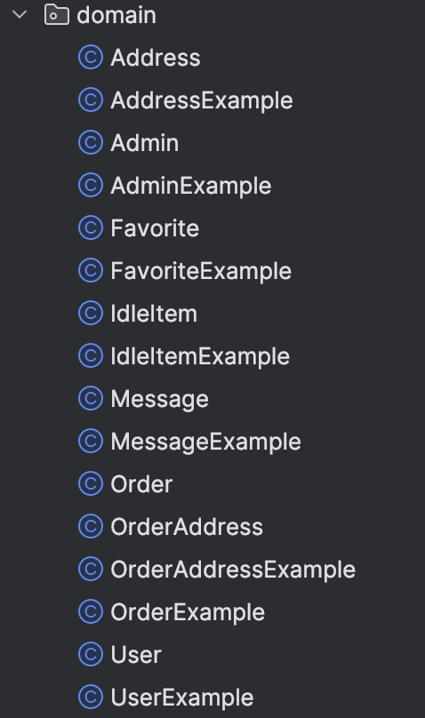
Class Diagram (Cont’d)
3
1
2
4
Notes:
specific textbook
narrow the listing – more related to BU students
include comments – no repeated questions for sellers – better user experience

Slide 8
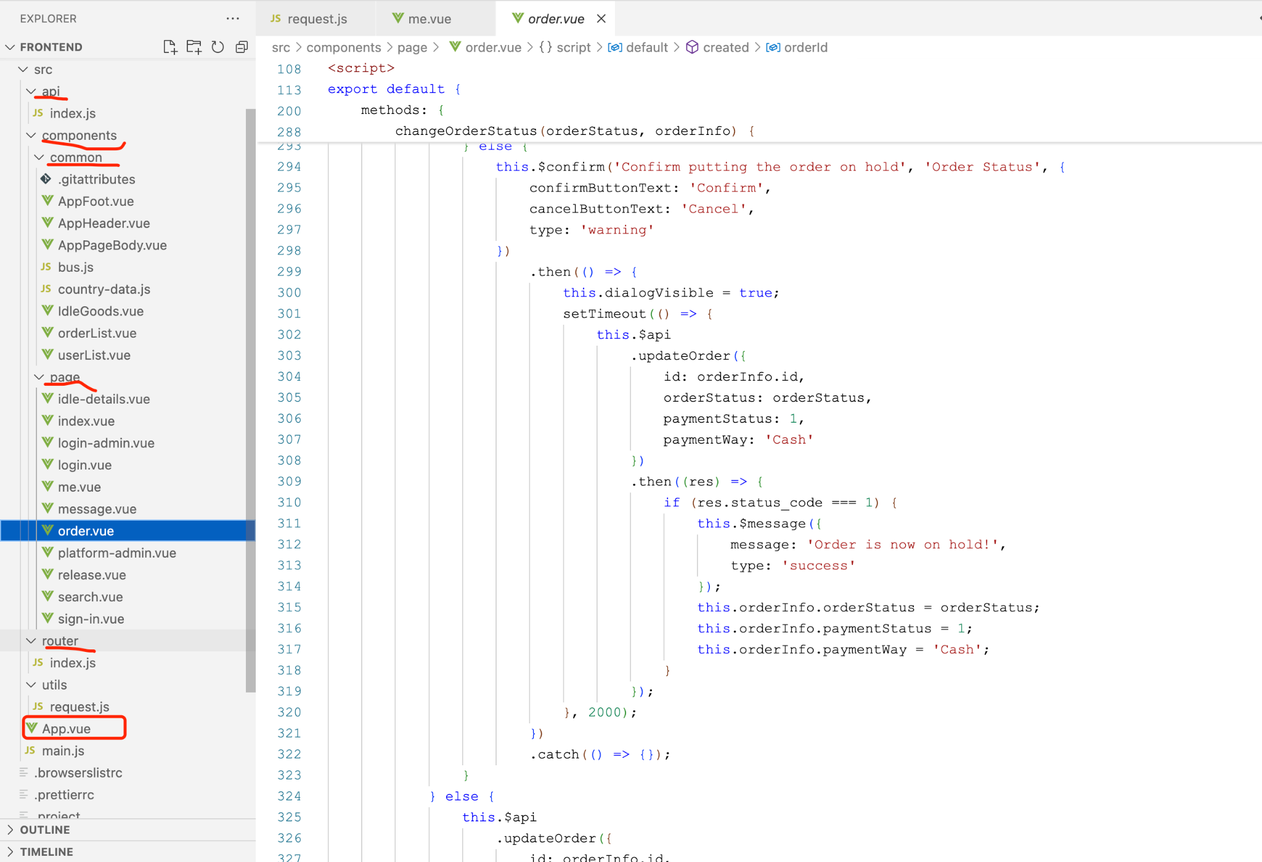
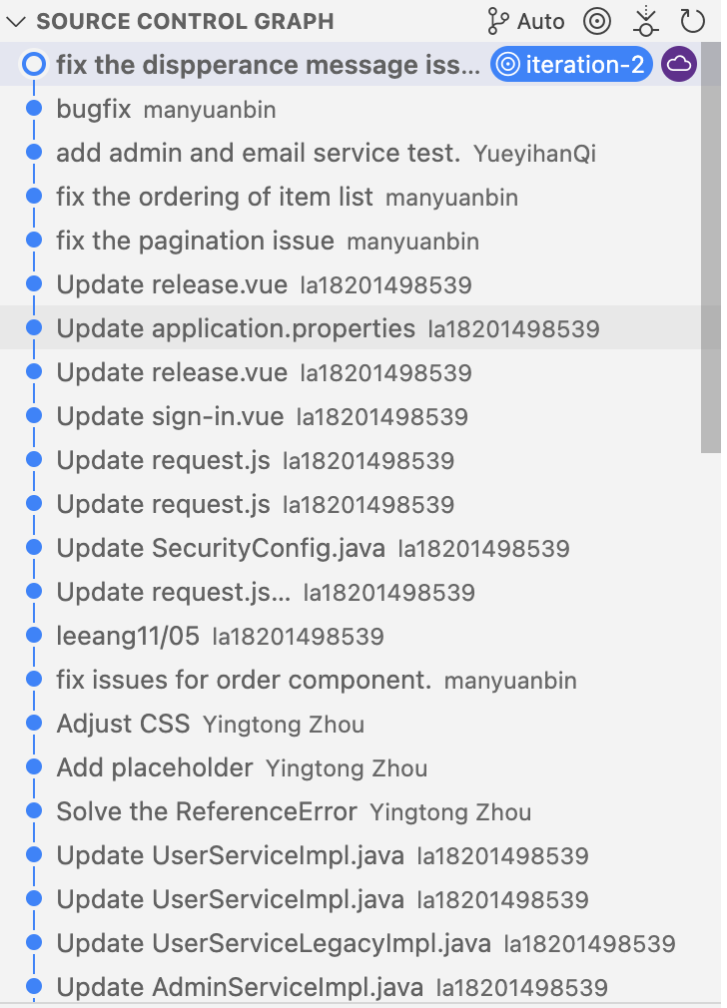
Frontend Design
Notes:
specific textbook
narrow the listing – more related to BU students
include comments – no repeated questions for sellers – better user experience

Slide 9
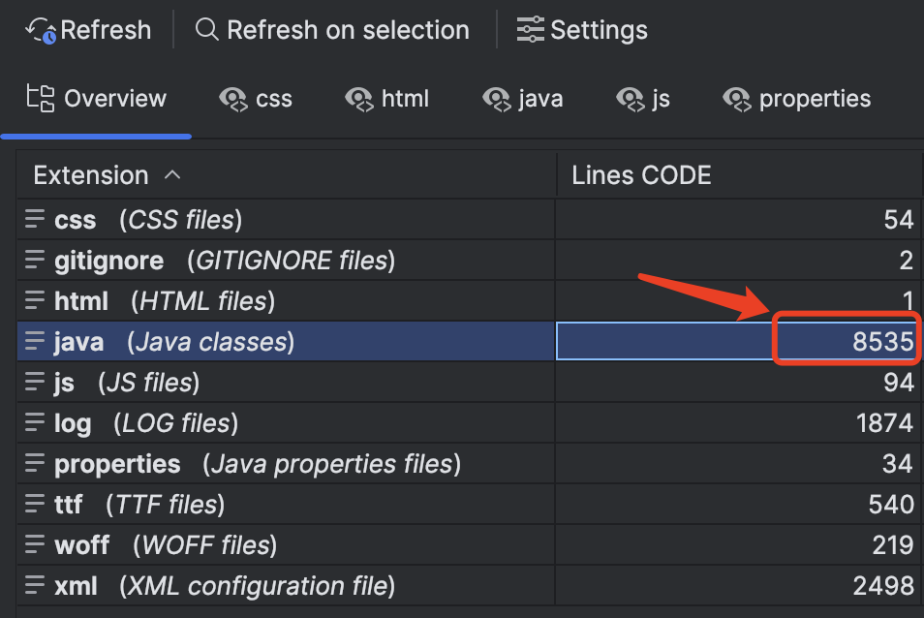
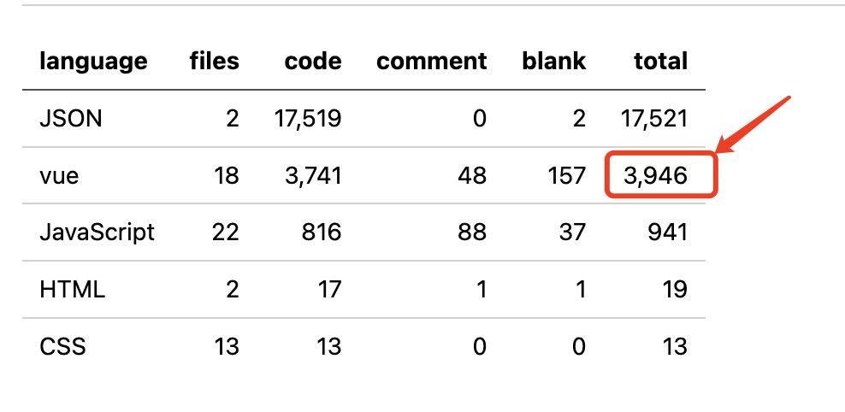
Backend and Frontend Code Summary
Frontend
Backend
Notes:
hard to locate the item you’re interested in.

Slide 10
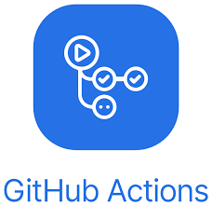

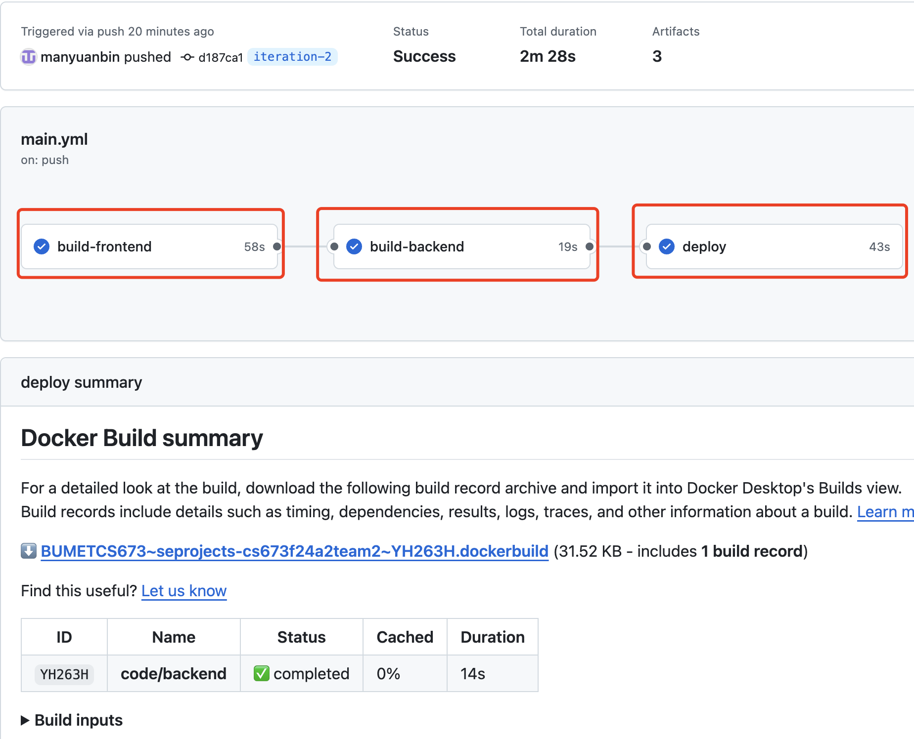
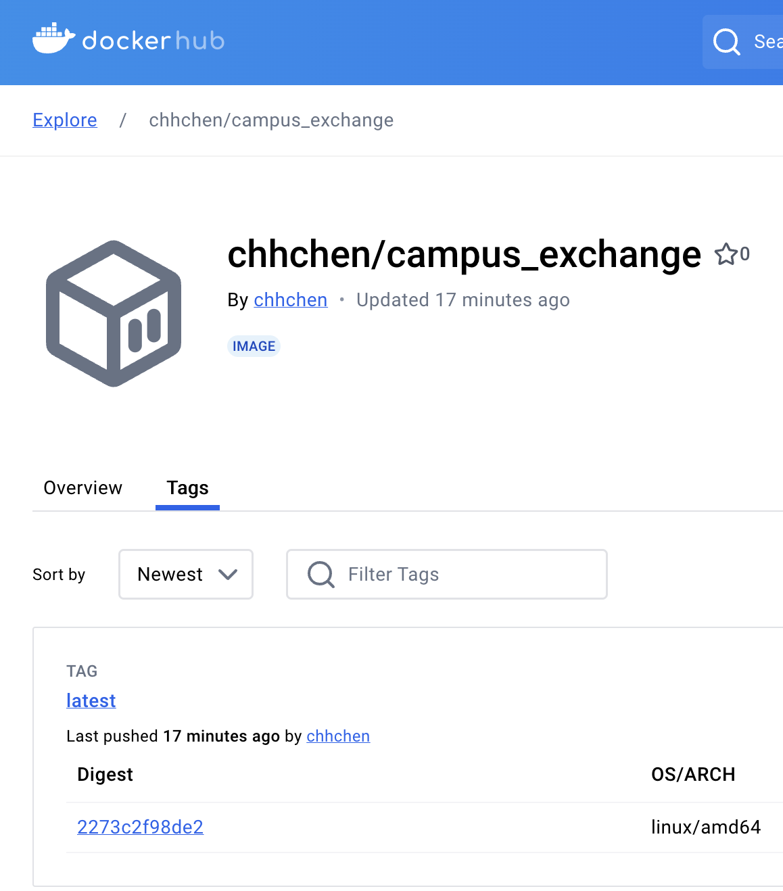
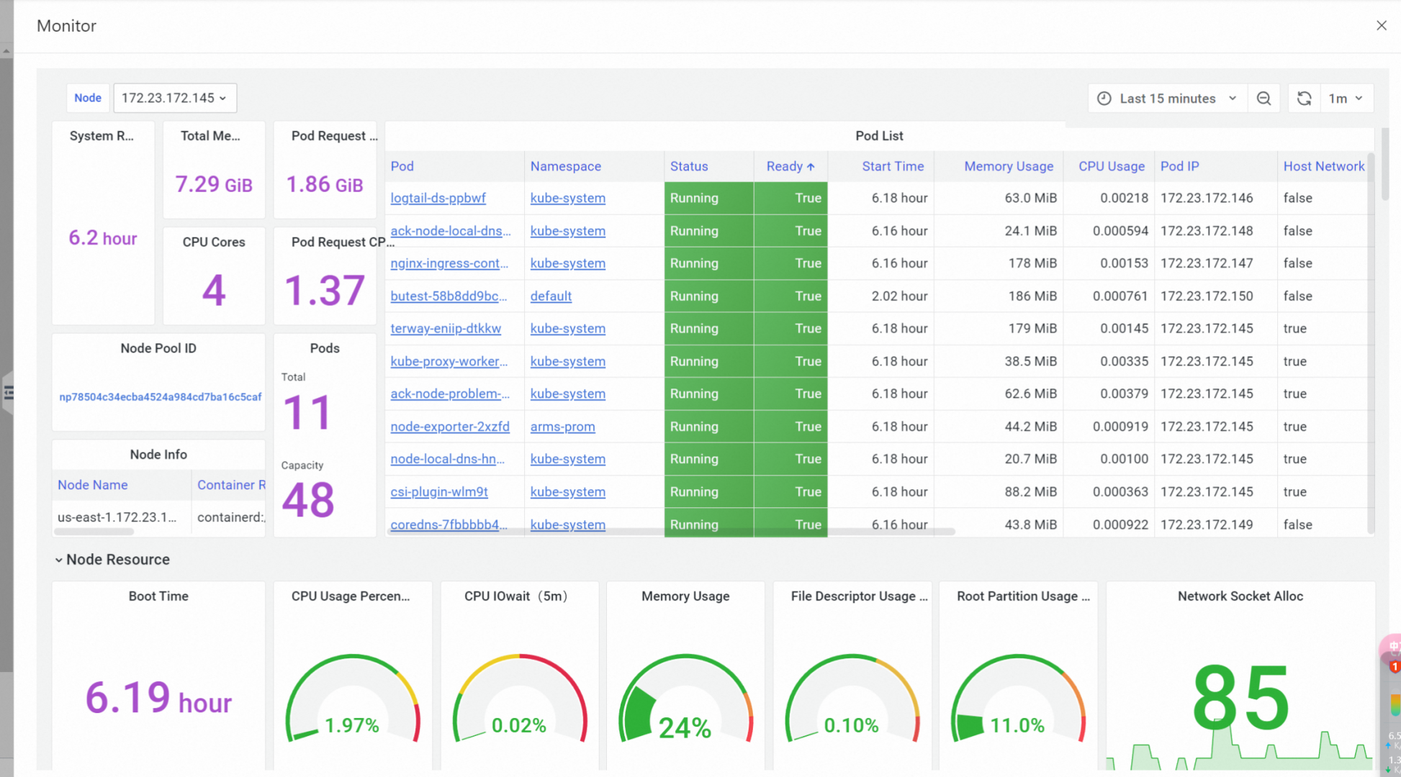
CI/CD
Code
Docker
Service
https://hub.docker.com/r/chhchen/campus_exchange/
Notes:
Alibaba Cloud‘s K8s offers advantages like auto-scaling, high availability, which enables efficient management of containerized applications.
Redis: data consistency between memory and disk.
This product offers features like automatic backups, high availability, and read-write separation, ensuring data reliability and efficiency.

Slide 11
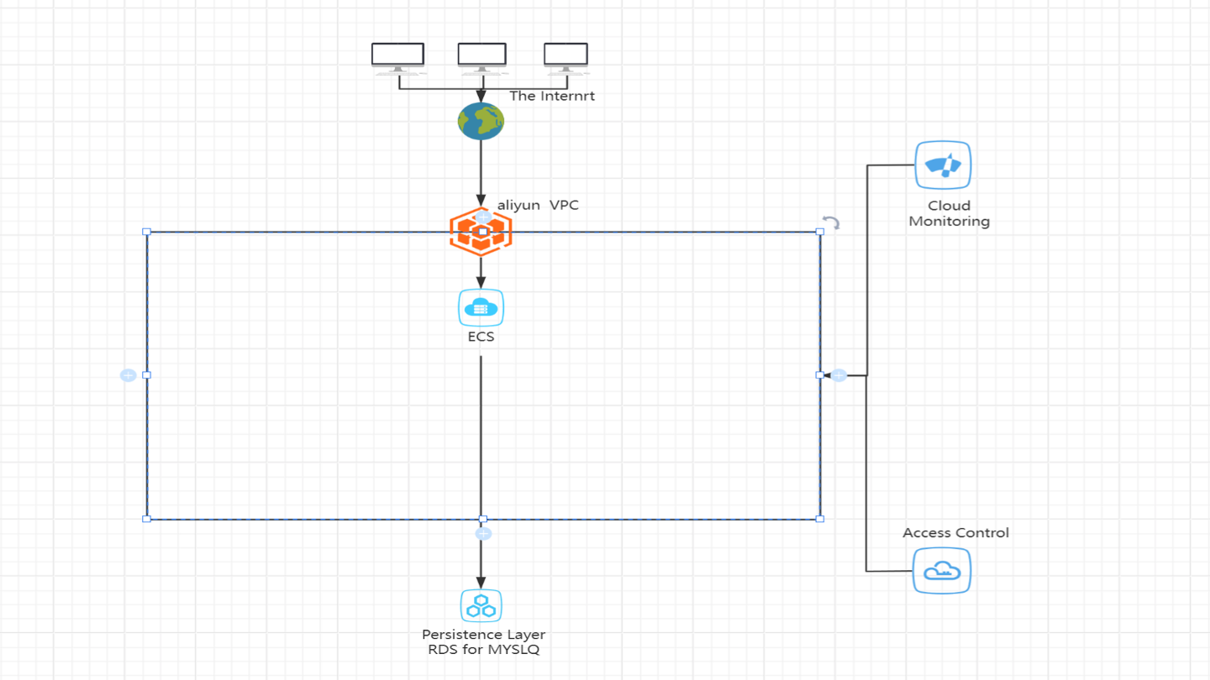
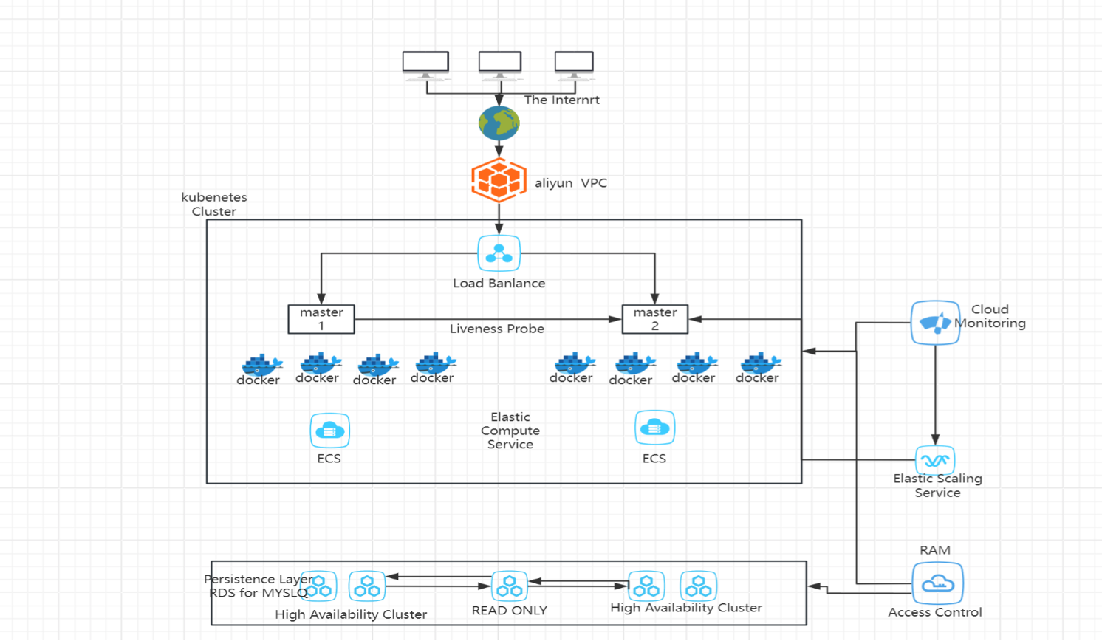
Infra. on Alibaba Cloud
Iter-1
Iter-2
Notes:
Alibaba Cloud‘s K8s offers advantages like auto-scaling, high availability, which enables efficient management of containerized applications.
Redis: data consistency between memory and disk.
This product offers features like automatic backups, high availability, and read-write separation, ensuring data reliability and efficiency.

Slide 12




Quality Assurance and Testing
software disasters
Quality must be built into software from the beginning to prevent issues and reduce costs.
Focus on early defect management, aiming to find and fix issues as soon as possible in development.
Code reviews during merges help maintain standards and catch defects early.
Testing is continuous and spans the entire lifecycle, including:
Unit, modular, integration, functional, performance, stress, smoke, and acceptance testing.
Involvement from developers, QA professionals, and third-party testers.
Key QA goals for the project: ensure functionality, usability, and performance of the application.

Slide 13
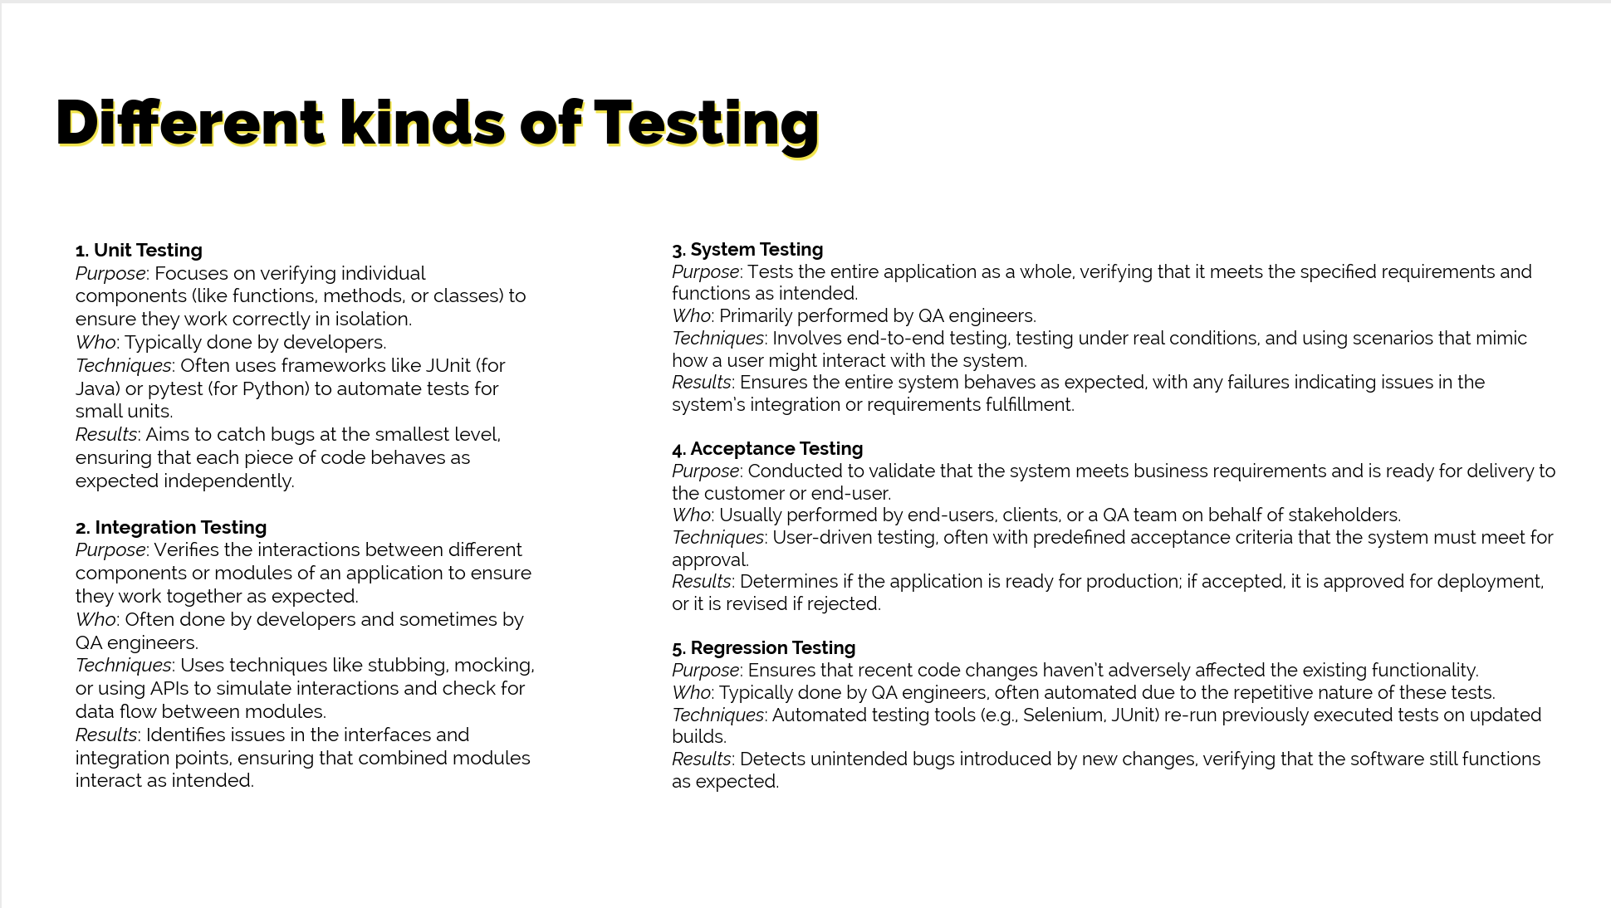

Slide 14
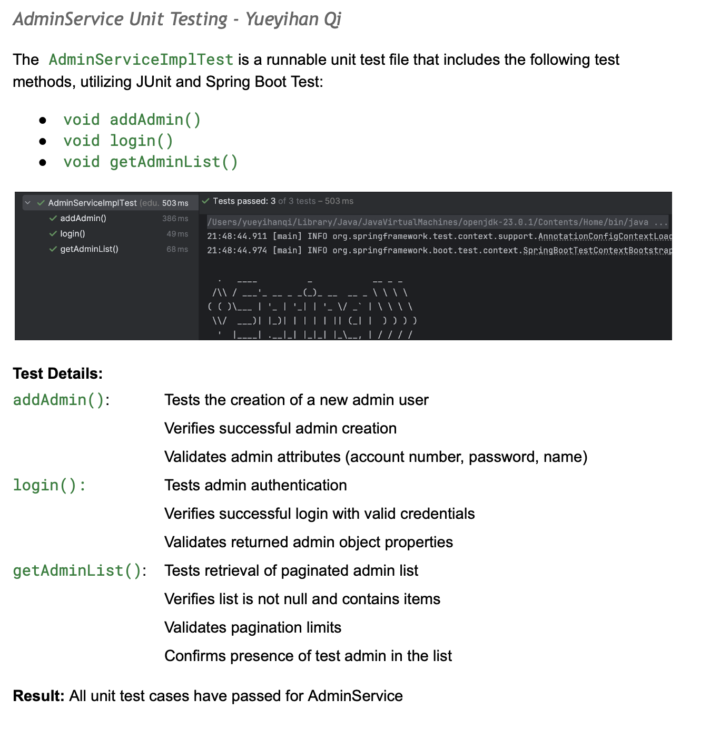
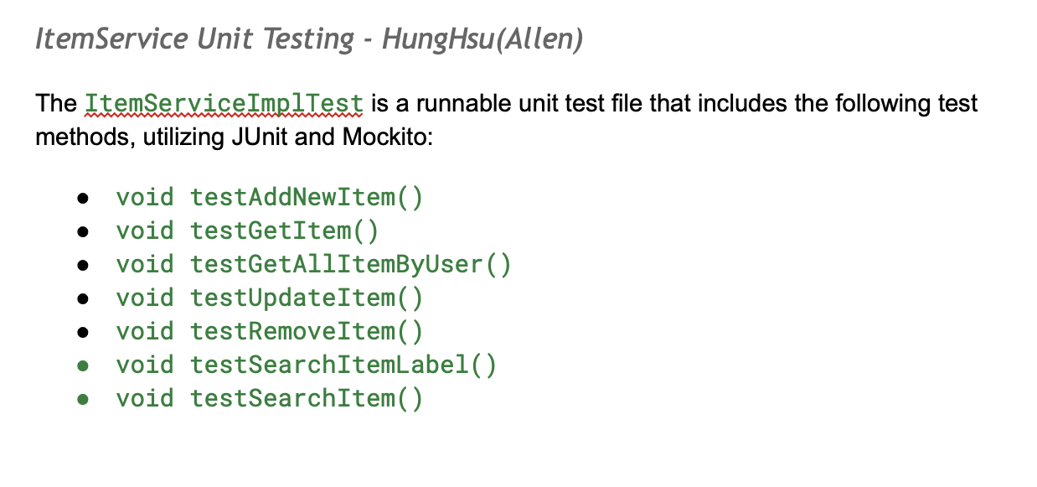
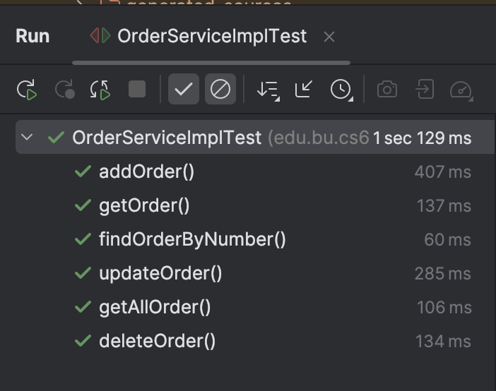

Slide 15
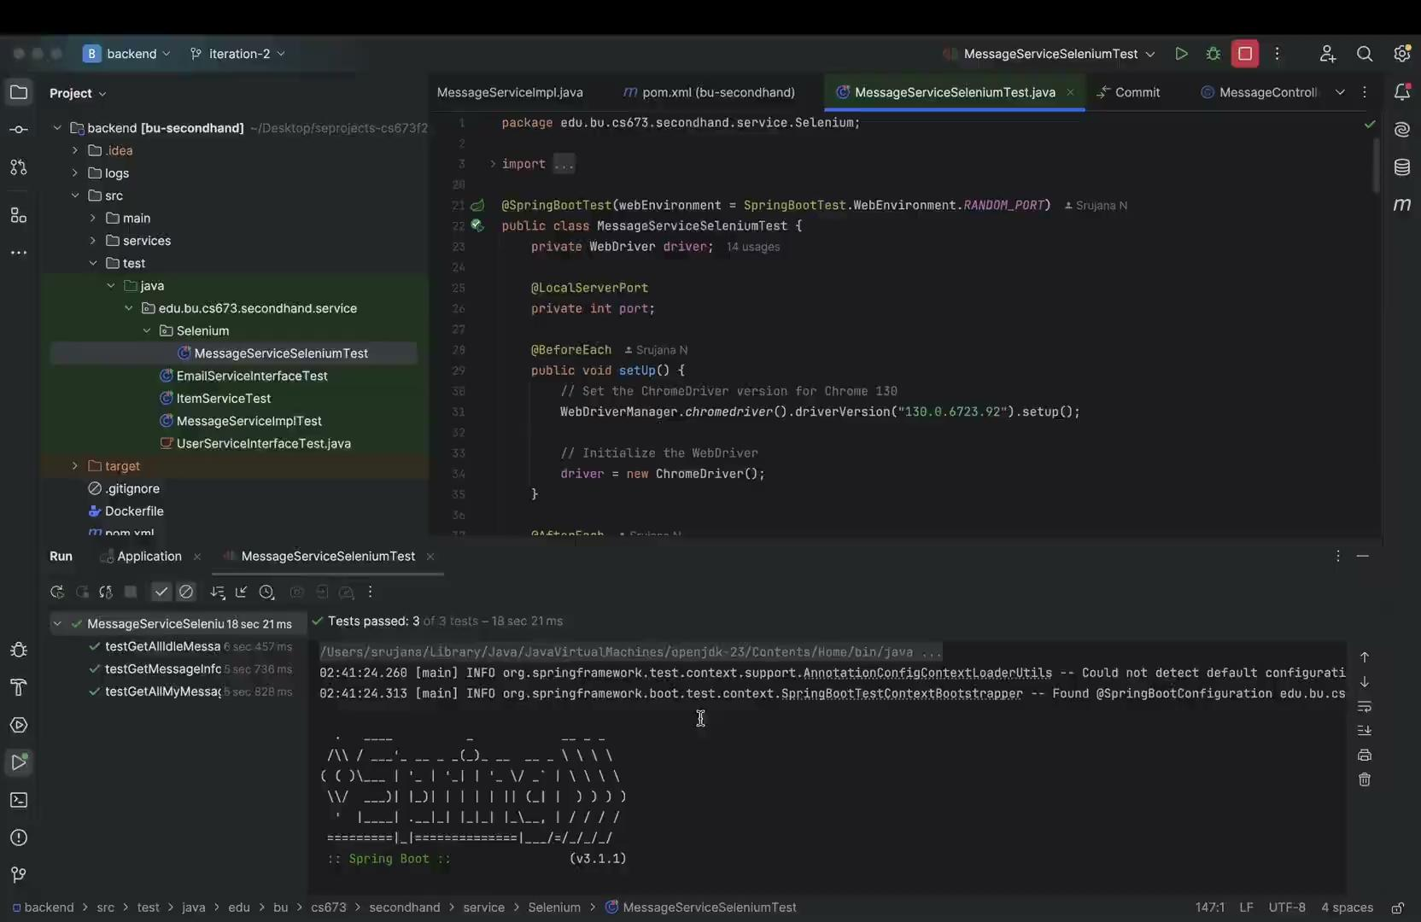

Slide 16
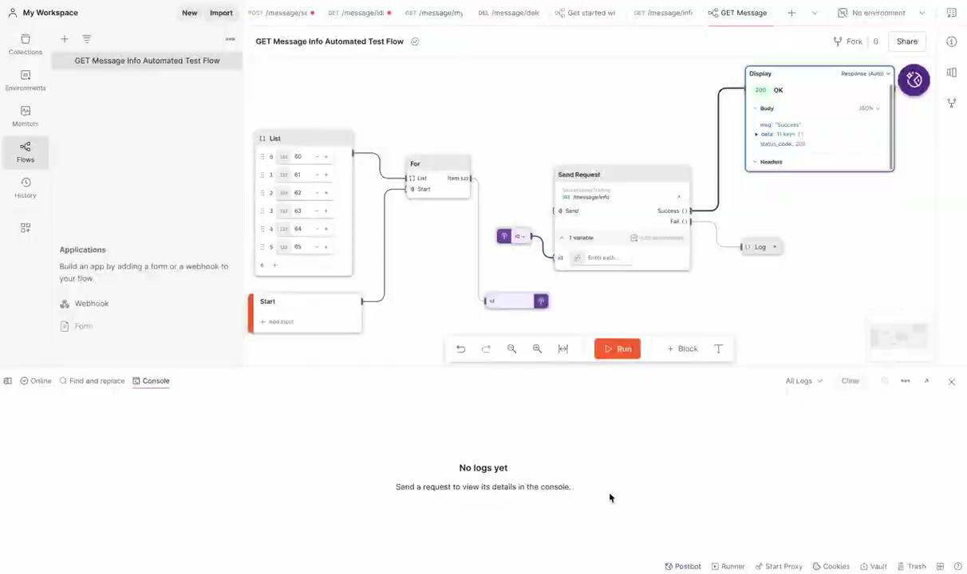

Slide 17
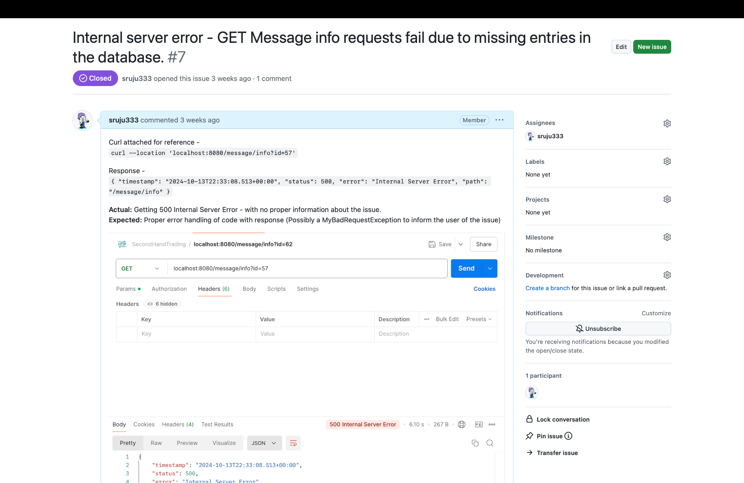
Using GitHub for Bug Tracking

Slide 18
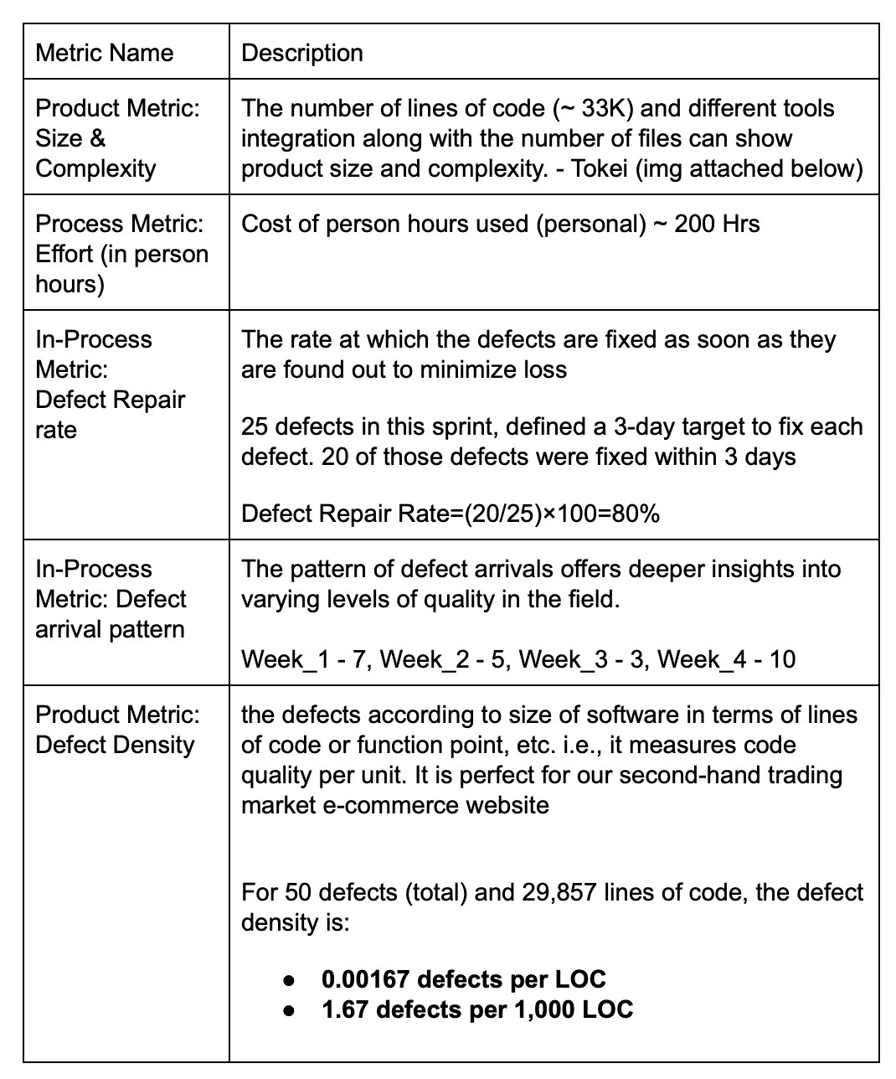
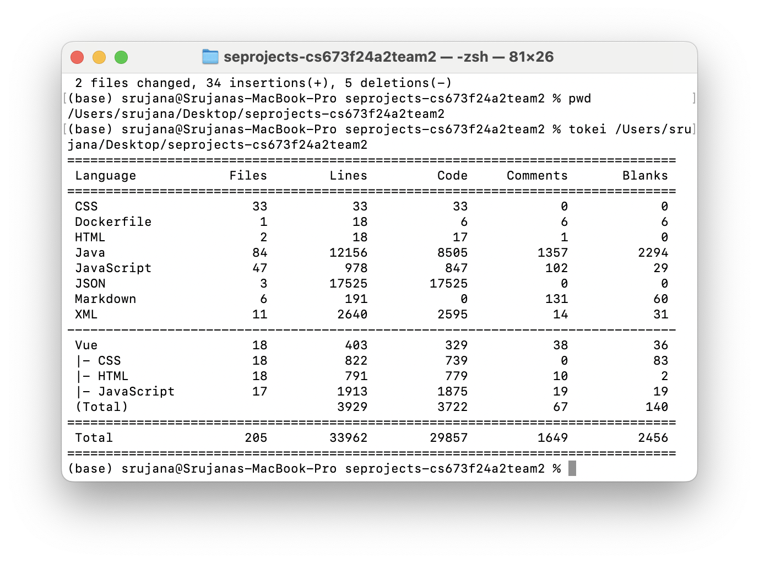
Testing Metrics

Slide 19
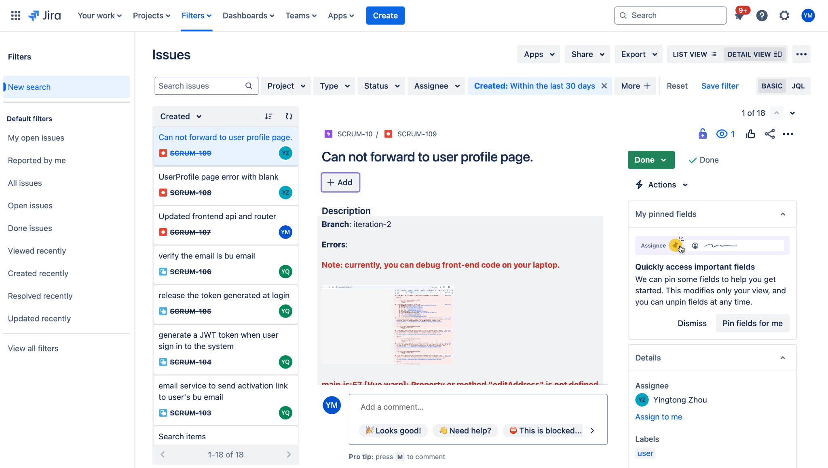
Open Issues
Notes:
To wrap the ideas up, we have divided our project into some key development phases
KPIs: User Acquisition, Listings Growth, Transaction Success, Retention Rate.

Slide 20
Milestones and Iteration Plan
Iteration 1 – Oct 17 2024
MVP Development (user registration, item listing, comments)
Stable database and cache system configuration
Iteration 2 – Nov 7 2024
Enhanced Features (chat, geolocation, AI search and recommend)
QA plan and continuous testing
Iteration 3 – Dec 5 2024
Post-launch feedback collection from students
Future QA plan - admin user testing, performance & load and user acceptance testing
Notes:
To wrap the ideas up, we have divided our project into some key development phases
KPIs: User Acquisition, Listings Growth, Transaction Success, Retention Rate.

Slide 21
Thank you!

